Slide 1

Collaborating with others on GitHub
Eirini Zormpa, 5 July 2023

Slide 2
Summary of last week
Last week we learned:
✅ That GitHub is an online website to host repositories tracked with git, something very useful for collaboration
✅ How to connect local and remote repositories (in this case, ones shared on GitHub)
✅ That branches are independent lines of development, useful for experimenting with new features without breaking anything
✅ How to create and merge branches
✅ How to open and merge pull requests to suggest changes

Slide 3
Questions from last time?

Slide 4
Learning objectives
By the end of this session, you’ll be able to:
Explain what a fork is and when to use it
Request reviews for your pull requests
Understand when merge conflicts happen and how to resolve them
Set up a GitHub repository to facilitate collaboration
Use issues to discuss and document changes

Slide 5

Collaboration mechanisms on GitHub
Image credit: collaboration by Iconathon from The Noun Project, freely available on the public domain.

Slide 6




Person 3
Suggests a change but doesn’t edit the files
Person 1, 2 & 3
script
script-v2
script-v3
Meta document
Project history
?
Next steps
Person 1
Resources
Person 4
Bugs
Person 2
script-v2_test-new-feature
?
script-workflow
Helps with testing new feature
Slide is intentionally overwhelming & horrible to look at

Slide 7
How to collaborate?
If you have access
If you don’t have access
The only person that, by default, can make changes to a personal repository is the person that created it.
The repo owner can add collaborators, who can contribute directly by committing to main, or by creating a branch and submitting a pull request.
If you have not been added as a collaborator, you can make a copy of the repo, called a fork, into you own account.
You can then suggest the changes to the original (upstream) repo through a pull request.
🌟

Slide 8
Collaboration mechanisms on GitHub
No need to type along - just watch 👀
Image credit: coding by putrakali735 from The Noun Project shared under a CC-BY 3.0 licence.

Slide 9
fork vs. branch

Slide 10


How to collaborate?
If you have access
If you don’t have access
If you don’t have access
The only person that, by default, can make changes to a personal repository is the person that created it.
The repo owner can add collaborators, who can contribute directly by committing to main, or by creating a branch and submitting a pull request.
If you have not been added as a collaborator, you can make a copy of the repo, called a fork, into you own account.
You can then suggest the changes to the original (upstream) repo through a pull request.
Image credit: open eye by verry poernomo, closed eye by Виталий Плут from The Noun Project shared under a CC-BY 3.0 licence.

Slide 11
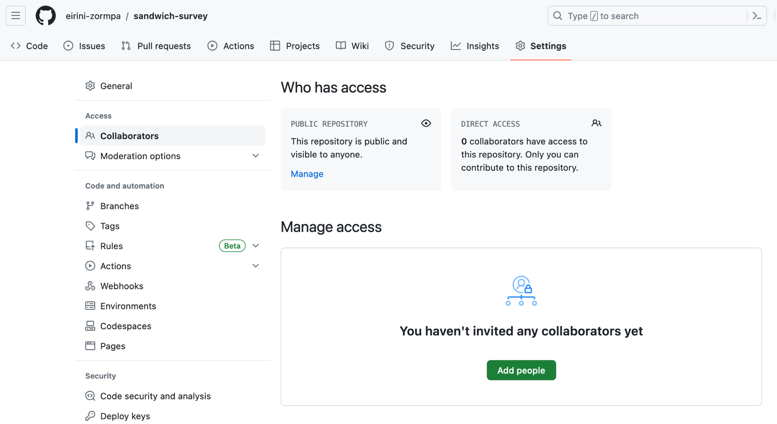

Slide 12
Repository 1
Person 3
Oh no 😭
Person 1, 2 & 3
Meta-document
Person 1
Person 4
Repository 3
Repository 2
Person 2
Person 3
Person 3
Person 1, 2 & 3
Meta-document
Person 1, 2 & 3
Person 1
Person 4
Meta-document
Person 2
Slide is intentionally overwhelming & horrible to look at
Person 1
Person 4
Person 2

Slide 13

GitHub Organisations
collaborator 1
collaborator 2
allow you to work with the same collaborators on multiple projects
keep a collaborations’ work centralised with less disruption if one person stops being involved
organisation account
collaborator 3

Slide 14
Account types on GitHub
Enterprise accounts
Personal account
Organisation account
Everyone that uses GitHub has a personal account. Personal accounts can own resources such as repos.
Any time you do something on GitHub (make a commit, submit a pull request, etc), that action is associated with your account.
Organisations are shared accounts, where multiple people can collaborate across many projects at once.
Organisations can own resources, but they are not associated with actions; the user’s personal account is.

Slide 15
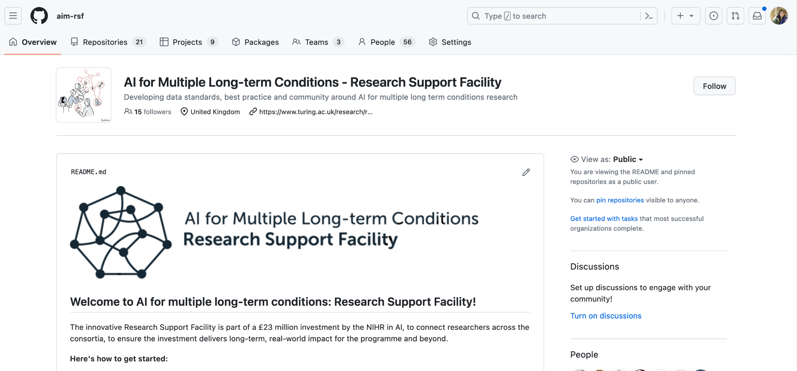
GitHub Organisation of the AI for Multiple Long-term Conditions Research Support Facility (AIM RSF)

Slide 16
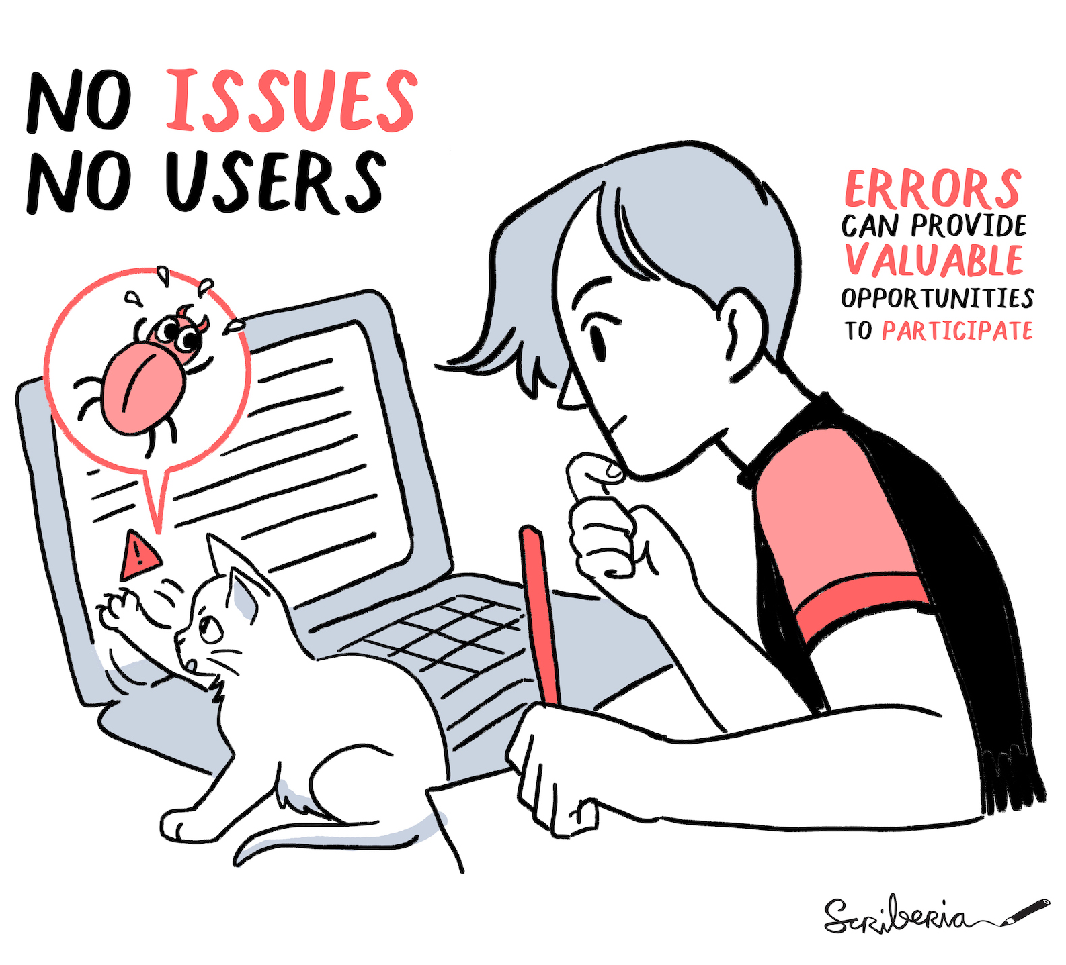
Collaborate with issues
Issues are like posts in a repository.
Use them to flag things that should be changed: bugs or errors that need to be fixed or new features that could be added to enhance the repository.
When thinking about contributing to a repo, check the issues to see what’s needed!

Slide 17
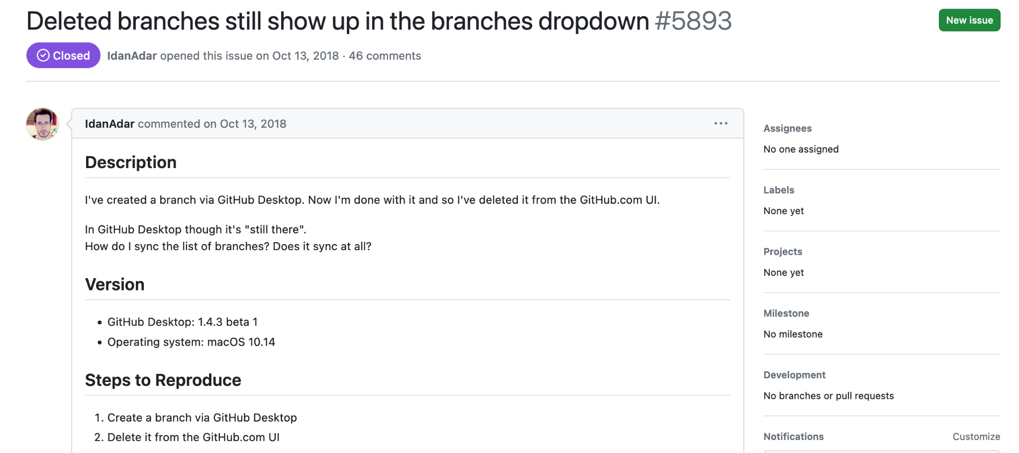
Link to issue.

Slide 18
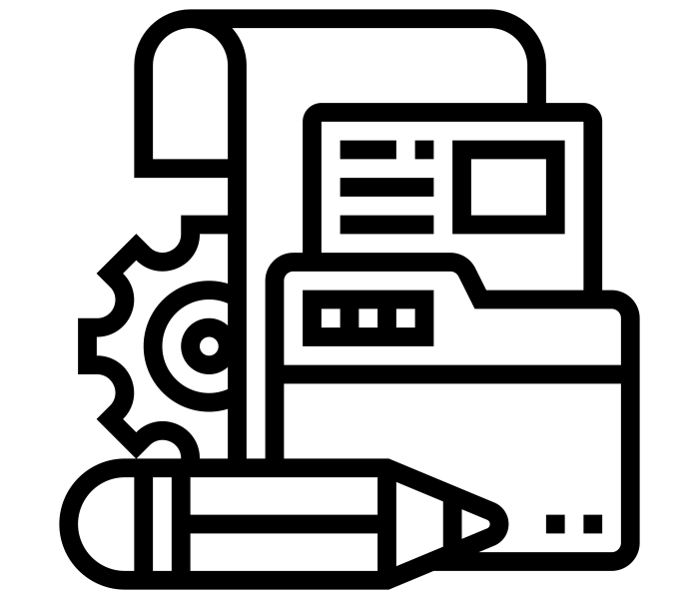
Documenting for collaboration
Image credit: documentation by Eucalyp from The Noun Project shared under a CC-BY 3.0 licence.

Slide 19
If your repo isn’t documented, people won’t know what it’s about

Slide 20
If your repo isn’t documented, people won’t know what it’s about, how to use it

Slide 21
If your repo isn’t documented, people won’t know what it’s about, how to use it and how to contribute.

Slide 22


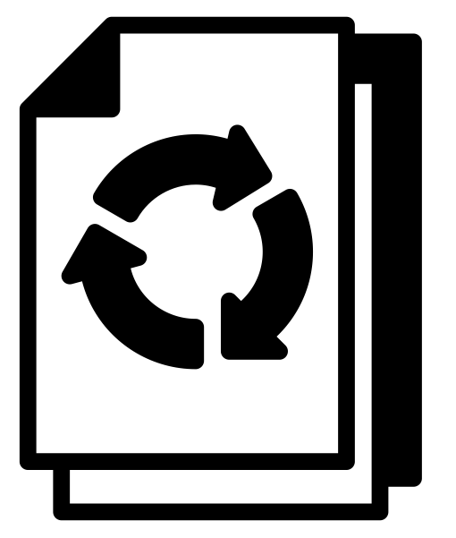

Documentation
README.md
CONTRIBUTING.md
LICENCE
CODE_OF_CONDUCT.md
Image credit: document by Alfan Zulkarnain, puzzle and reuse by Tippawan Sookruay, contract law by Weltenraser from The Noun Project shared under a CC-BY 3.0 licence.

Slide 23
Documentation
Used to describe the project and provide important information. “README” is recognised by GitHub and displayed as a landing page.
Essential
README.md
CONTRIBUTING.md
LICENCE
CODE_OF_CONDUCT.md
Image credit: document by Alfan Zulkarnain, puzzle and reuse by Tippawan Sookruay, contract law by Weltenraser from The Noun Project shared under a CC-BY 3.0 licence.

Slide 24
Documentation
Used to give instructions to prospective collaborators on what you need help with, where they can suggest new ideas, what mechanism to use to propose actual changes.
Optional, but highly recommended
README.md
CONTRIBUTING.md
LICENCE
CODE_OF_CONDUCT.md
Image credit: document by Alfan Zulkarnain, puzzle and reuse by Tippawan Sookruay, contract law by Weltenraser from The Noun Project shared under a CC-BY 3.0 licence.

Slide 25
Documentation
Used to set the project usage terms. Different projects require difference licence types; I would recommend OSI-approved for software, Creative Commons otherwise.
Essential
README.md
CONTRIBUTING.md
LICENCE
CODE_OF_CONDUCT.md
Image credit: document by Alfan Zulkarnain, puzzle and reuse by Tippawan Sookruay, contract law by Weltenraser from The Noun Project shared under a CC-BY 3.0 licence.

Slide 26
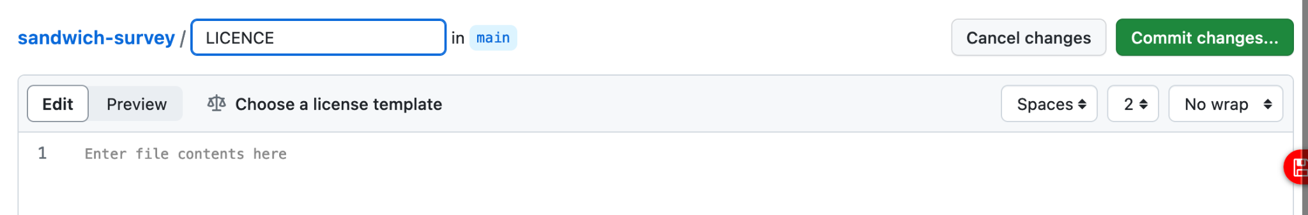
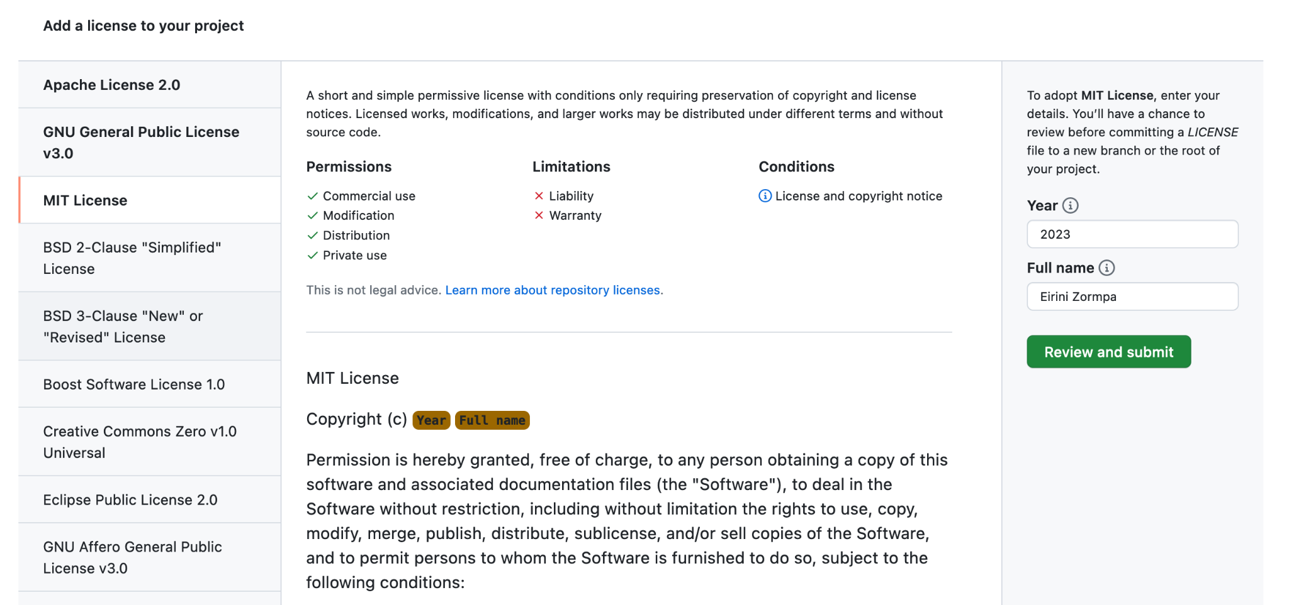
Add file > Create new file

Slide 27
Documentation
Used to describe the expected behaviour from collaborators and contributors. It should give examples of (un)desirable behaviours and the process for dealing with breaches.
Optional, but highly recommended
README.md
CONTRIBUTING.md
LICENCE
CODE_OF_CONDUCT.md
Image credit: document by Alfan Zulkarnain, puzzle and reuse by Tippawan Sookruay, contract law by Weltenraser from The Noun Project shared under a CC-BY 3.0 licence.

Slide 28

Acknowledging all contributions 🤝
GitHub will automatically track the contributors who have made commits to repository files. But not all contributors push code! Consider:
📒 project management
🔎 reviewing pull requests
🐛 finding bugs
💪 suggest improvements
Read about All Contributors; See an example.

Slide 29
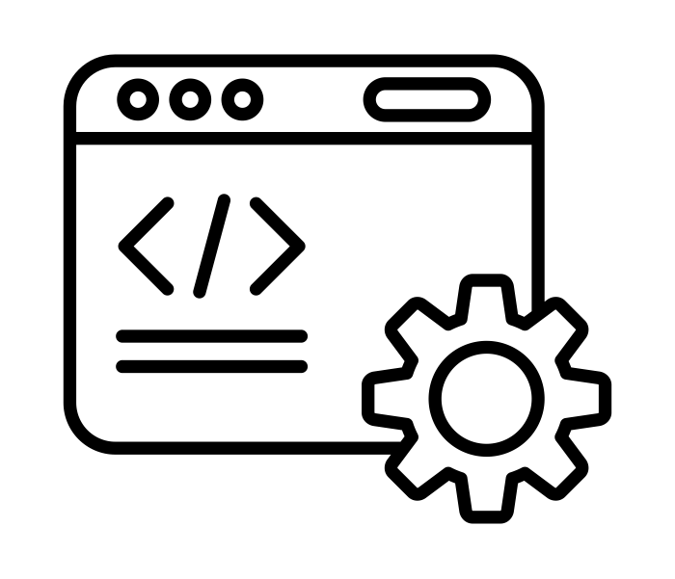
Time to collaborate!
Image credit: coding by putrakali735 from The Noun Project shared under a CC-BY 3.0 licence.

Slide 30
Exercise
Go to the training repository of the AIM RSF organisation
Fork the repository into your account
Navigate to the folder version control > hi.md
Follow the instructions in the document
Commit your change
Contribute the change to the upstream repository via a pull request. If you can see the option, add me (eirini-zormpa) or Rachael (RayStick) as reviewers.

Slide 31
Collaboration ideas 🧠✨
Create documentation for your existing projects
Publish one of your repositories on GitHub (if that is possible)
Create an issue in a repository with a suggestion for improvement (or to fix a link, or correct typos)
Comment on an issue that you could contribute to
See the HackMD for documentation templates and repository suggestions!

Slide 32
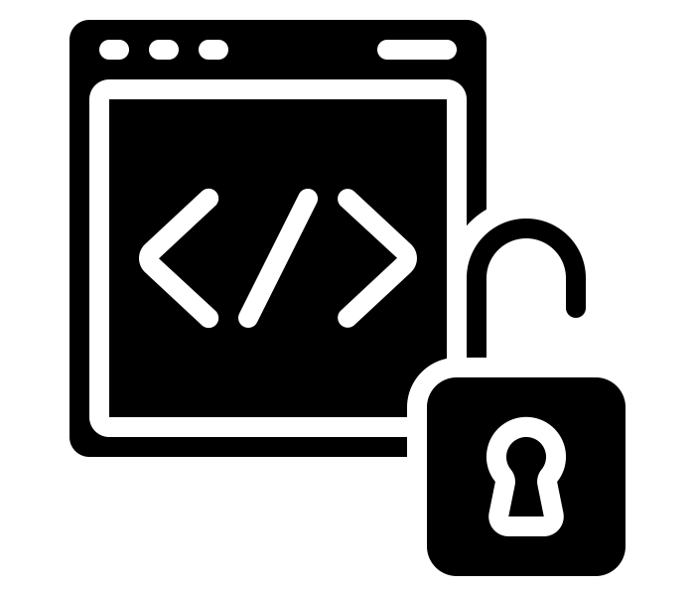
Open source
Image credit: open source by Juicy Fish from The Noun Project shared under a CC-BY 3.0 licence.

Slide 33
Open source software
“Open source software is software with source code that anyone can inspect, modify, and enhance.”
Open source software development typically involves open sharing of work and collaboration.
Contributing to open source software can help you build your existing skills or develop new ones, advance your career, and meet people with similar interests
Quote from the “What is open source” blog post on opensource.com; see the Open Source Definition on the Open Source Initiative website; some content from the Open Source Software chapter of The Turing Way

Slide 34

Hacktoberfest website.

Slide 35
Any final questions?

Slide 36
